Slide 1
b2d_plate
Unrestricted

Slide 2






Breakfast Lunch Dinner meal ideas
We help you to plan your breakfast lunch and dinner meals in just one click everyday.

Slide 3

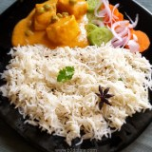
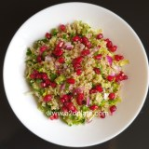
Today’s b2d meal idea (click here to get the recipes )
Breakfast : Banana pancake with berries
Lunch : Jeera rice with matar paneer
Dinner : Bulgar wheat salad

Slide 4
In the previous slide
When the heading is clicked in the previous slide, it goes to the blog to open a page where all 3 recipes links are shown.
They can check the recipe.
Next slide will give them a total 7 day meal plan.
They can click on the Day number and it goes to our same meal plan page in the blog where they can click and check the recipes.

Slide 5
http://www.b2dplate.com/Todays-b2d-meal-day-88
The link is for the slide number 3 heading.

Slide 6
7 day b2d meal plan
B2D meal Day 1
B2D meal Day 2
B2D meal Day 3
B2D meal Day 4
B2D meal Day 5
B2D meal Day 6
B2D meal Day 7
(meal day is a clickable link which goes to the page in the blog)

Slide 7
Thank you
See you tomorrow with new meal plan ☺

